Slide 1


Nadia Tariq
09/5/2024

Slide 2
Executive Summary
Introduction
Methodology
Results
Conclusion
Appendix
Data Science Capstone Project

Slide 3
Executive Summary
Collected data from public SpaceX API and SpaceX Wikipedia page. Created labels column ‘class’ which classifies successful landings. Explored data using SQL, visualization, folium maps, and dashboards. Gathered relevant columns to be used as features. Changed all categorical variables to binary using one hot encoding. Standardized data and used GridSearchCV to find best parameters for machine learning models. Visualize accuracy score of all models. • Four machine learning models were produced: Logistic Regression, Support Vector Machine, Decision Tree Classifier, and K Nearest Neighbors. All produced similar results with accuracy rate of about 83.33%. All models over predicted successful landings. More data is needed for better model determination and accuracy

Slide 4
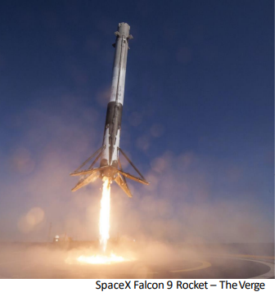
Introduction
Background:
• Commercial Space Age is Here
• Space X has best pricing ($62 million vs. $165 million USD)
• Largely due to ability to recover part of rocket (Stage 1)
• Space Y wants to compete with Space X Problem:
• Space Y tasks us to train a machine learning model to predict successful Stage 1 recovery

Slide 5

Section 1

Slide 6
Executive Summary
Methodology
Methodology 5
Data collection methodology:
Combined data from SpaceX public API and SpaceX Wikipedia page
Perform data wrangling
Classifying true landings as successful and unsuccessful otherwise
Perform exploratory data analysis (EDA) using visualization and SQL
Perform interactive visual analytics using Folium and Plotly Dash
Perform predictive analysis using classification models
Tuned models using GridSearchCV
6

Slide 7
Data Collection
Data collection process involved a combination of API requests from Space X public API and web scraping data from a table in Space X’s Wikipedia entry.
The next slide will show the flowchart of data collection from API and the one after will show the flowchart of data collection from webscraping.
Space X API Data Columns:
FlightNumber, Date, BoosterVersion, PayloadMass, Orbit, LaunchSite, Outcome, Flights, GridFins, Reused, Legs, LandingPad, Block, ReusedCount, Serial, Longitude,Latitude
Wikipedia Webscrape Data Columns:
Flight No., Launch site, Payload, PayloadMass, Orbit, Customer, Launch outcome, Version Booster, Booster landing, Date, Time

Slide 8
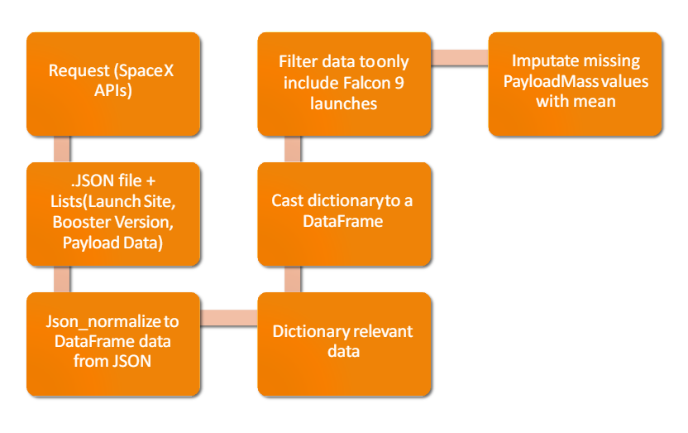
Data Collection – SpaceX API

Slide 9
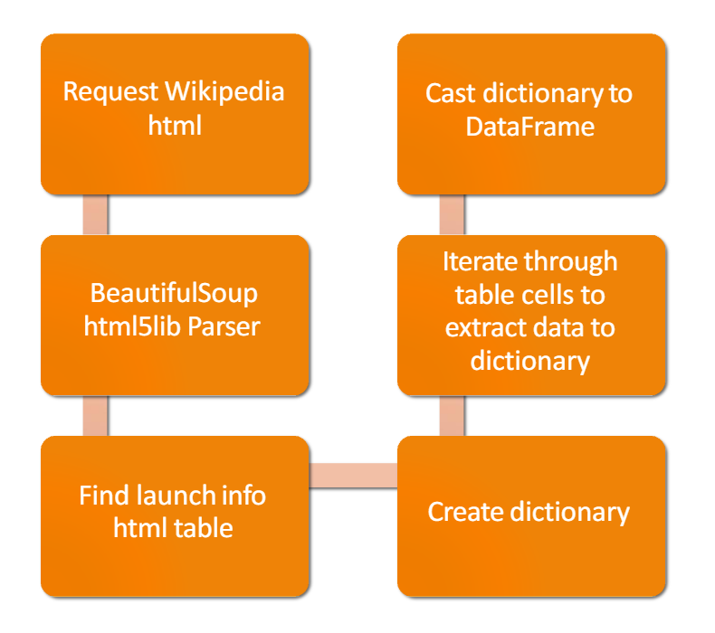
Data Collection - Scraping

Slide 10
Create a training label with landing outcomes where successful=1 & failure =0.
Outcome column has two components: ‘Mission Outcome’ ‘Landing Location’
New training label column ‘class’ with a value of 1 if ‘Mission Outcome’ is True and 0 otherwise.
Value Mapping:
True ASDS, True RTLS, & True Ocean – set to -> 1
None None, False ASDS, None ASDS, False Ocean, False RTLS – set to -> 0
Data Wrangling

Slide 11
Exploratory Data Analysis performed on variables Flight Number, Payload Mass, Launch Sites, Orrbit, Class and year.
Plots Used:
Create a training label with landing outcomes where successful = 1 & failure = 0. Outcome column has two components: ‘Mission Outcome’ ‘Landing Location’ New training label column ‘class’ with a value of 1 if ‘Mission Outcome’ is True and 0 otherwise. Value Mapping: True ASDS, True RTLS, & True Ocean – set to -> 1 None None, False ASDS, None ASDS, False Ocean, False RTLS – set to -> 0 .
Scatter plots, line charts, and bar plots were used to compare relationships between variables to decide if a relationship exists so that they could be used in training the machine learning model .
EDA with Data Visualization

Slide 12
EDA with SQL
Loaded data set into IBM DB2Database.
Queried using SQL Python integration.
Queries were made to get a better understanding of the dataset.
Queried information about launch site names, mission outcomes, various pay load sizes of customers and booster versions, and landing outcomes

Slide 13
Folium maps mark Launch Sites, successful and unsuccessful landings, and a proximity example to key locations: Railway, Highway, Coast, and City.
This allows us to understand why launch sites may be located where they are. Also visualizes successful landings relative to location.
Build an Interactive Map with Folium

Slide 14
Dashboard includes a pie chart and a scatter plot.
Pie chart can be selected to show distribution of successful landings across all launch sites and can be selected show individual launch site success rates.
Scatter plot takes two inputs: All sites or individual site and payload mass on a slider between 0 and 10000 kg.
The pie chart is used to visualize launch site success rate.
The scatter plot can help us see how success varies across launch sites, payload mass, and booster version category.
Build a Dashboard with Plotly Dash

Slide 15
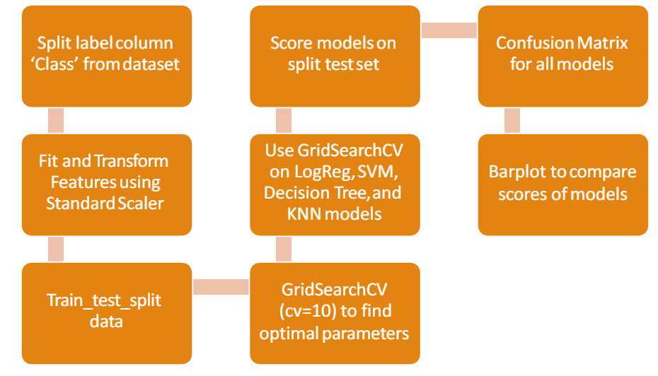
Predictive Analysis (Classification)

Slide 16
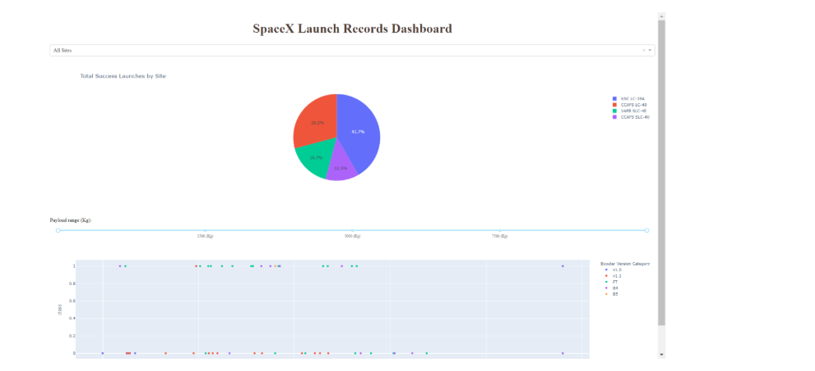
Results
This is a preview of the Plotly dashboard. The following sides will show the results of EDA with visualization, EDA with SQL, Interactive Map with Folium, and finally the results of our model with about 83% accuracy.

Slide 17

Section 2

Slide 18
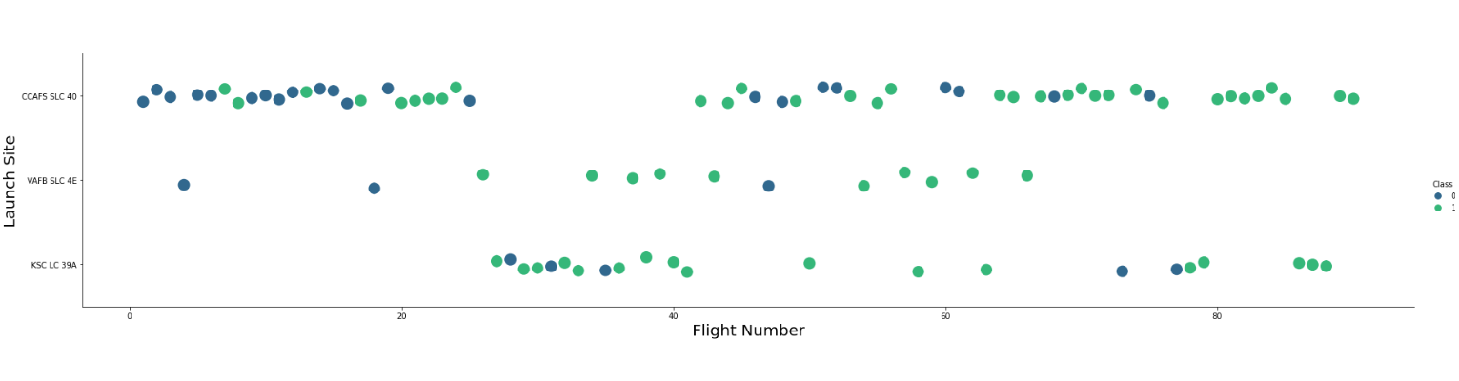
Flight Number vs. Launch Site

Slide 19
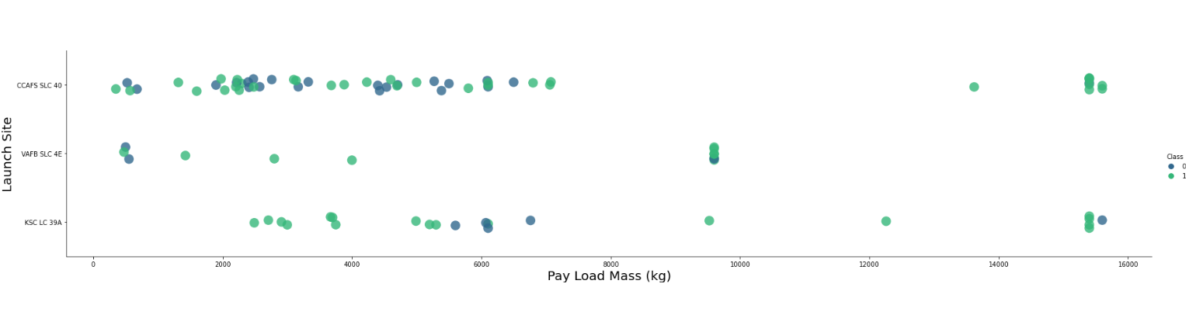
Payload vs. Launch Site

Slide 20
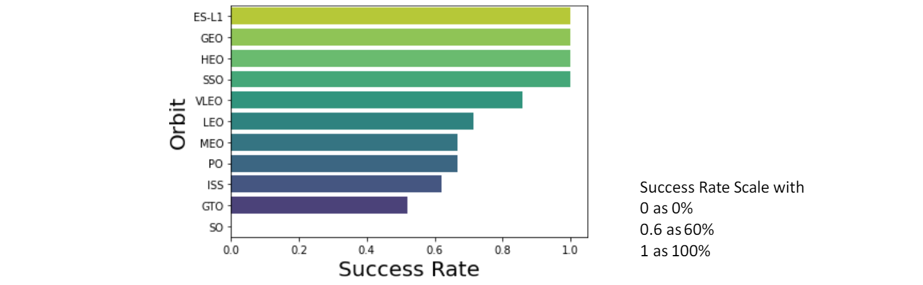
Success Rate vs. Orbit Type

Slide 21
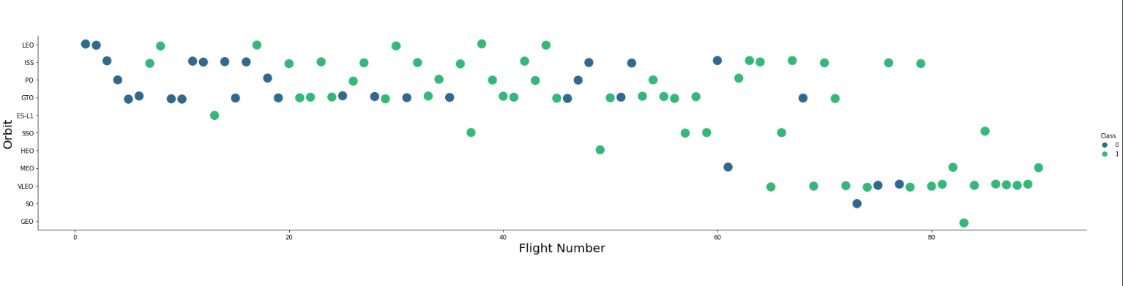
Flight Number vs. Orbit Type

Slide 22
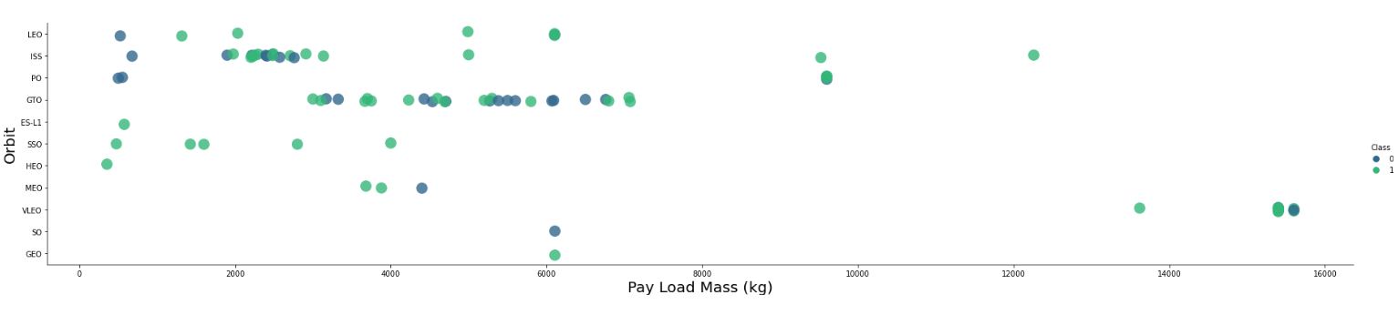
Payload vs. Orbit Type

Slide 23
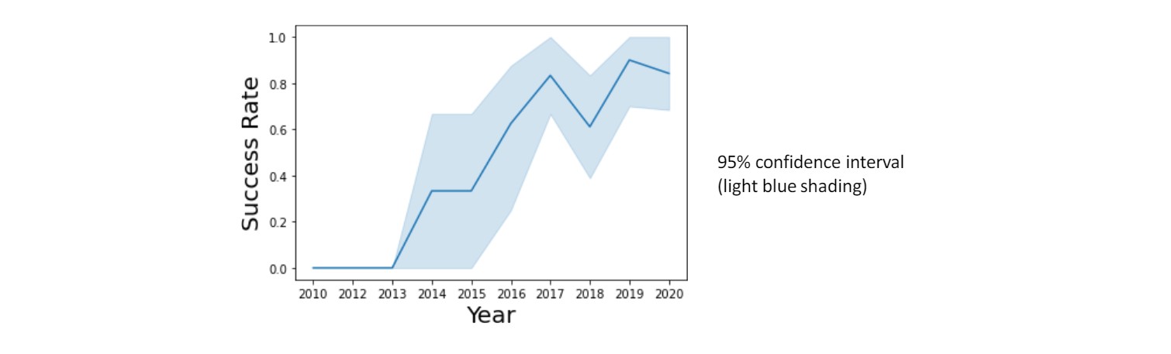
Launch Success Yearly Trend

Slide 24
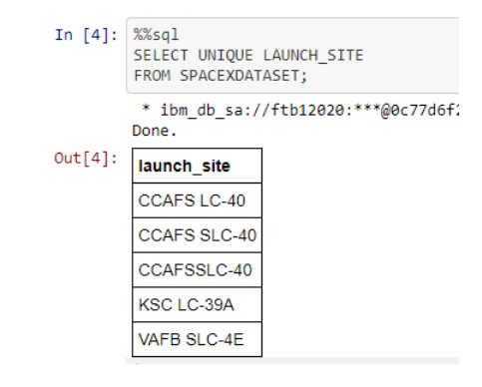
All Launch Site Names
Query unique launch site names from database.
CCAFS SLC-40 and CCAFSSLC-40 likely all represent the same launch site with data entry errors.
CCAFS LC-40 was the previous name.
Likely only 3 unique launch_site values:
CCAFS SLC-40, KSC LC-39A,VAFB SLC-4E

Slide 25
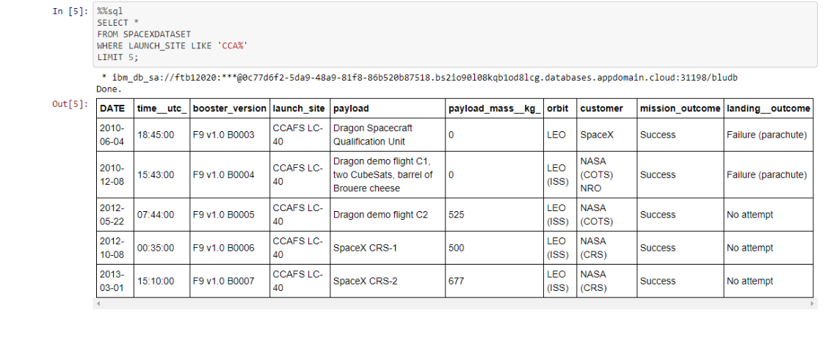
Launch Site Names Begin with 'CCA'

Slide 26
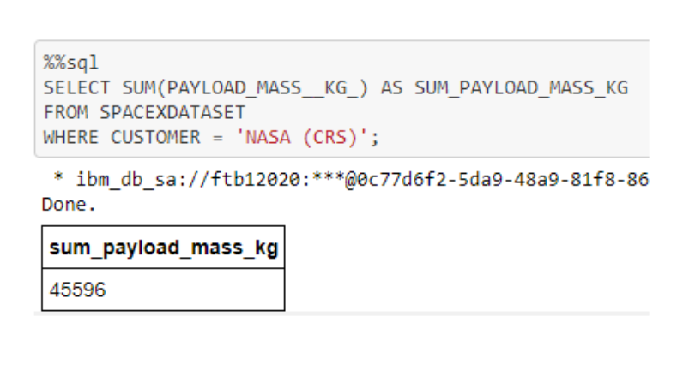
Total Payload Mass

Slide 27
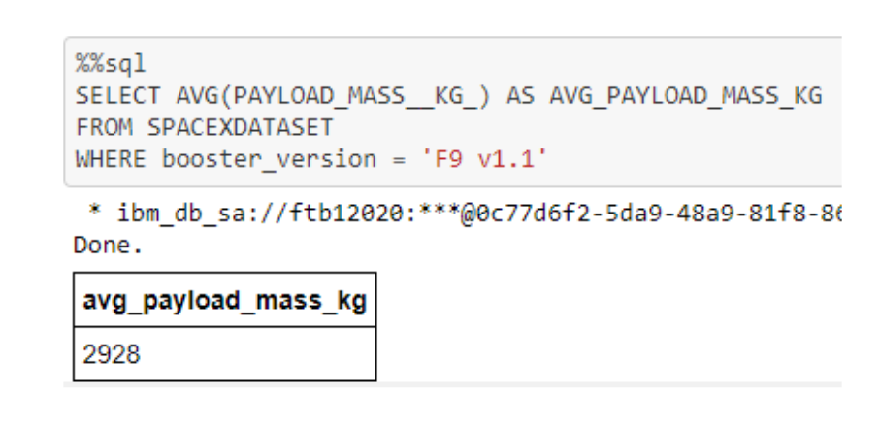
Average Payload Mass by F9 v1.1

Slide 28
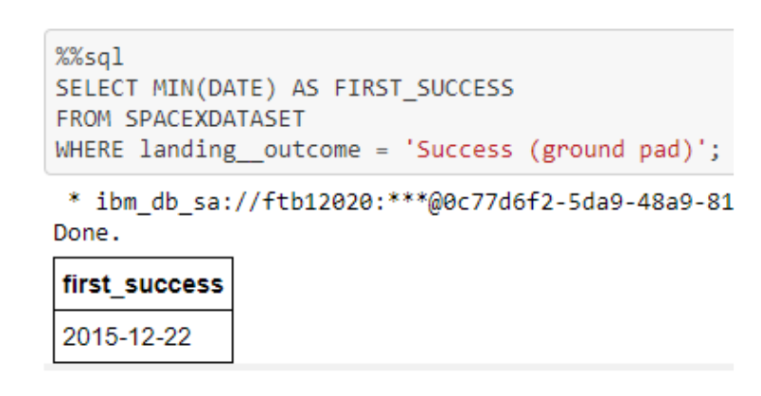
First Successful Ground Landing Date

Slide 29
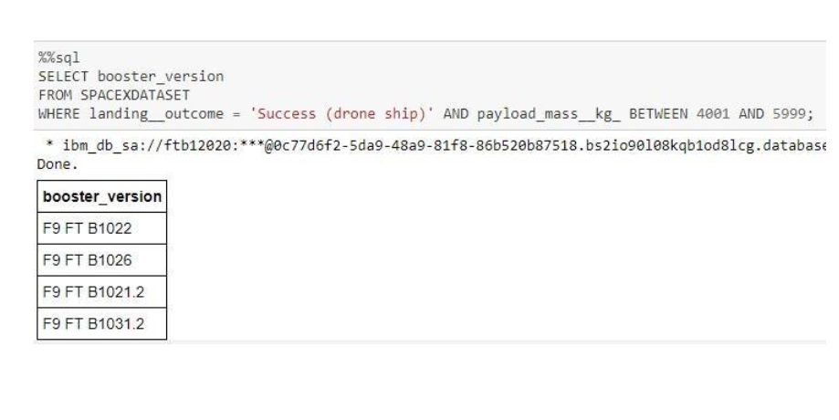
Successful Drone Ship Landing with Payload between 4000 and 6000

Slide 30
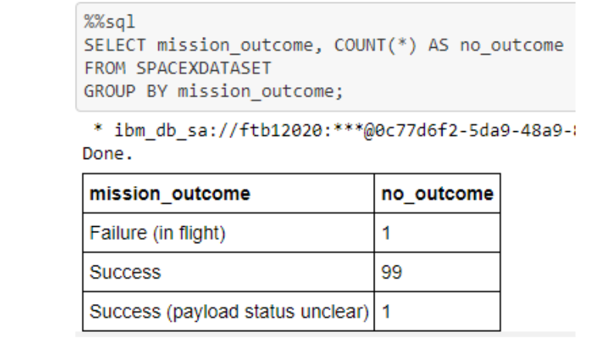
Total Number of Successful and Failure Mission Outcomes

Slide 31
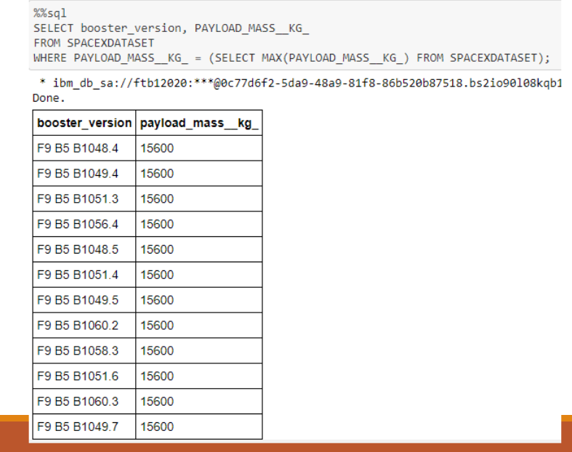
Boosters Carried Maximum Payload

Slide 32
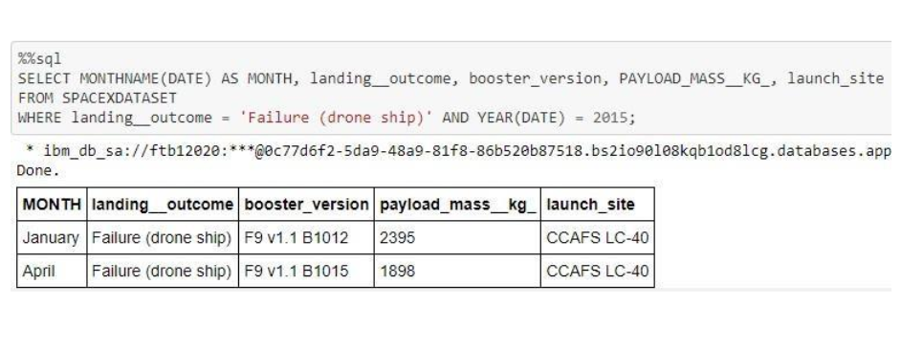
2015 Launch Records

Slide 33
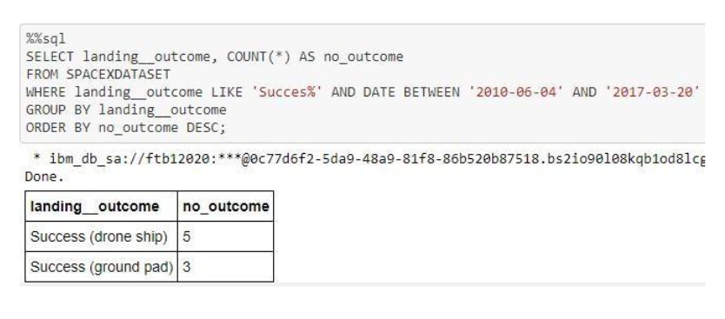
Rank Landing Outcomes Between 2010-06-04 and 2017-03-20

Slide 34

Section 3

Slide 35
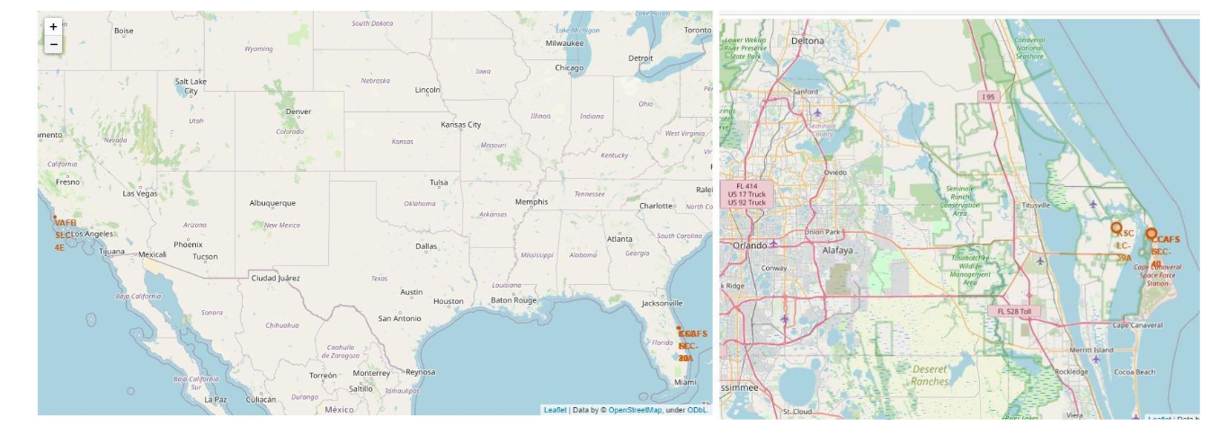
Launch Site Locations
The left map shows all launch sites relative US map. The right map shows the two Florida launch sites since they are very close to each other. All launch sites are near the ocean.

Slide 36
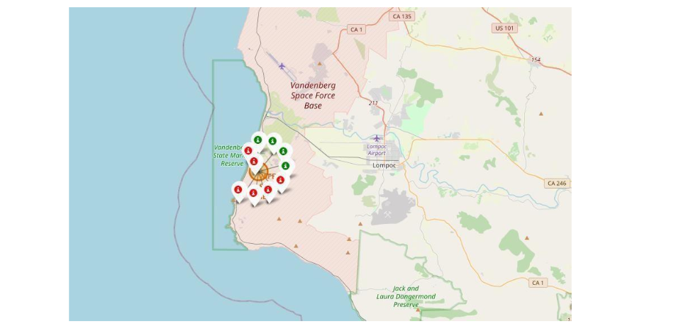
Color-Coded Launch Markers
Clusters on Folium map can be clicked on to display each successful landing (green icon) and failed landing (red icon). In this example VAFB SLC-4E shows 4 successful landings and 6 failed landings.

Slide 37
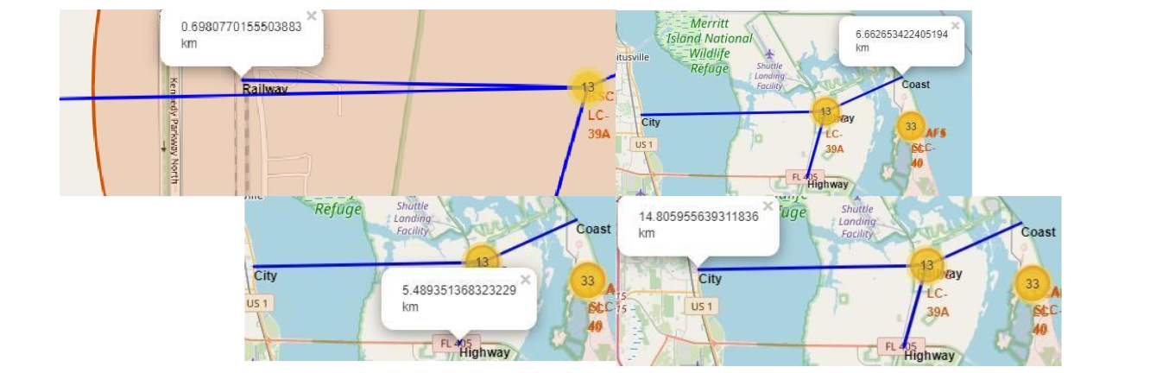
Key Location Proximities
Using KSC LC-39A as an example, launch sites are very close to railways for large part and supply transportation. Launch sites are close to highways for human and supply transport. Launch sites are also close to coasts and relatively far from cities so that launch failures can land in the sea to avoid rocketsfalling on densely populated areas.

Slide 38

Section 4

Slide 39
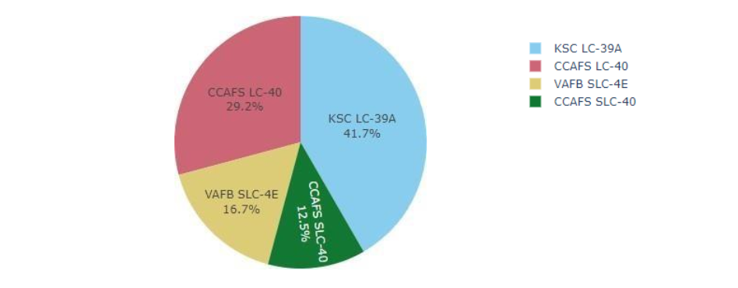
Successful Launches Across Launch Sites
This is the distribution of successful landings across all launch sites. CCAFS LC-40 is the old name of CCAFS SLC-40 so CCAFS and KSC have the same amount of successful landings, but a majority of the successful landings where performed before the name change. VAFB has the smallest share of successful landings. This may be due to smaller sample and increase in difficulty of launching in the west coast.

Slide 40
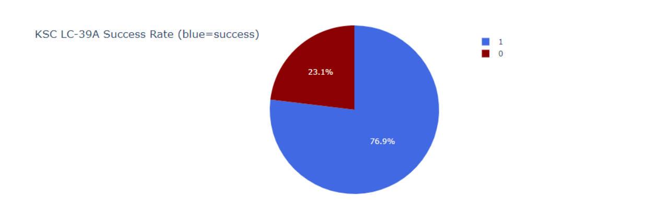
Highest Success Rate Launch Site
KSC LC-39A has the highest success rate with 10 successful landings and 3 failed landings.

Slide 41
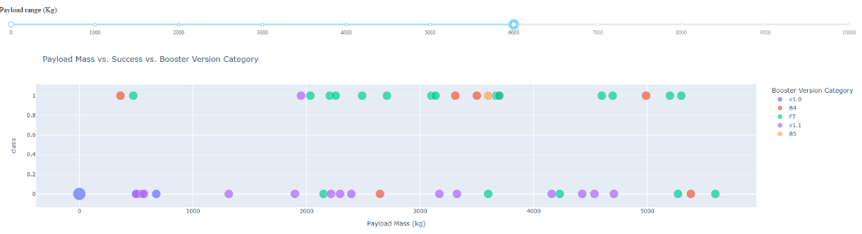
Payload Mass vs. Success vs. Booster Version Category
Plotly dashboard has a Payload range selector. However, this is set from 0-10000 instead of the max Payload of 15600. Class indicates 1 for successful landing and 0 for failure. Scatter plot also accounts for booster version category in color and number of launches in point size. In this particular range of 0-6000, interestingly there are two failed landings with payloads of zero kg.

Slide 42

Section 5

Slide 43
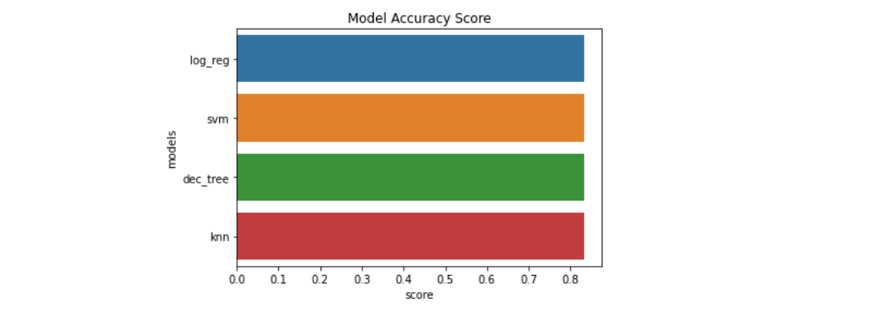
Classification Accuracy

Slide 44
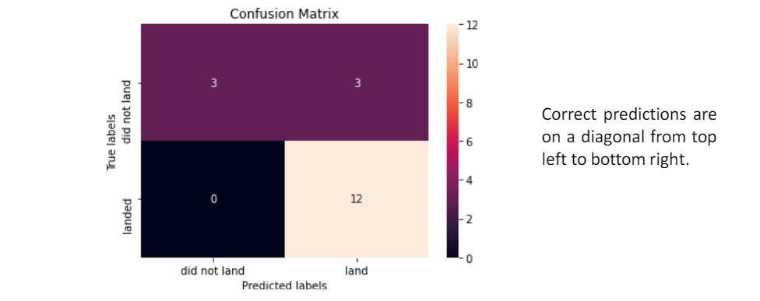
Confusion Matrix

Slide 45
Conclusions
Our task: to develop a machine learning model for Space Y who wants to bid against SpaceX
The goal of model is to predict when Stage 1 will successfully land to save ~$100 million USD
Used data from a public SpaceX API and web scraping SpaceX Wikipedia page
Created data labels and stored data into a DB2 SQL database
Created a dashboard for visualization
We created a machine learning model with an accuracy of 83%
Elon Musk of SpaceX can use this model to predict with relatively high accuracy whether a launch will have a successful Stage 1 landing before launch to determine whether the launch should be made or not
If possible more data should be collected to better determine the best machine learning model and improve accuracy

Slide 46

Appendix
Instructors: Rav Ahuja, Alex Aklson, Aije Egwaikhide, Svetlana Levitan, Romeo Kienzler, Polong Lin, Joseph Santarcangelo, Azim Hirjani, Hima Vasudevan, Saishruthi Swaminathan, Saeed Aghabozorgi, Yan Luo
GitHub repository URL: https://github.com/dia4605/IBM_Data_Science_Professional_Certification

Slide 47


